Slide 1
BM424 Clinical Microbiology Workshops: Pandemic Response
Workshop 5
Dr. Morgan Feeney and Dr. Arnaud Javelle
2023

Slide 2
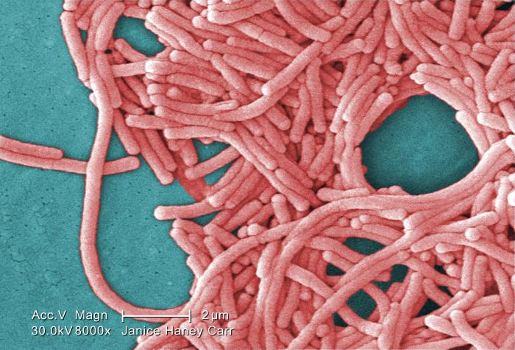
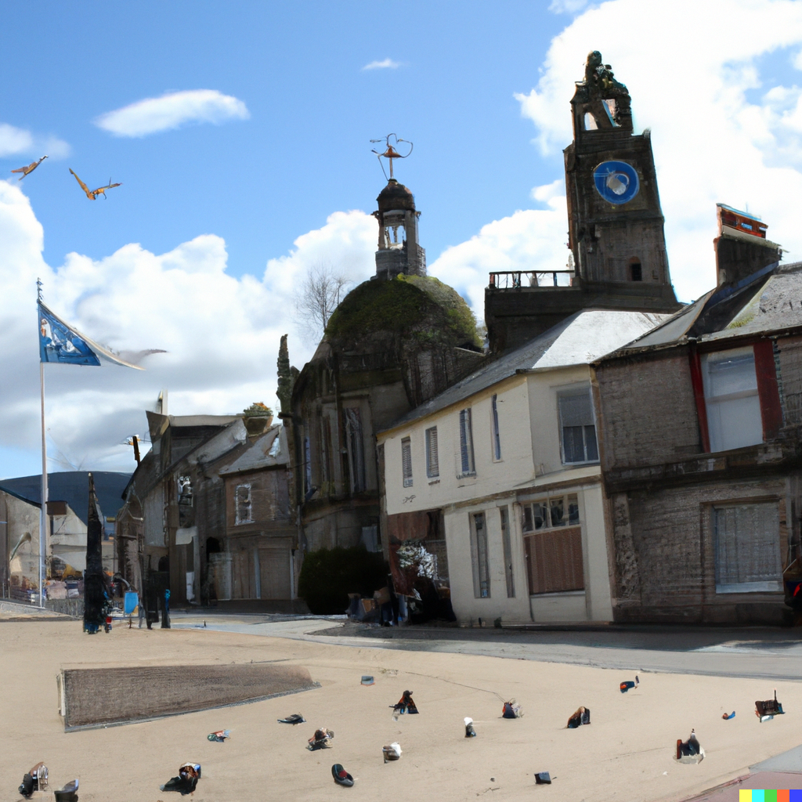
Scenario A: Legionella pneumophila in Inverkeld

Slide 3
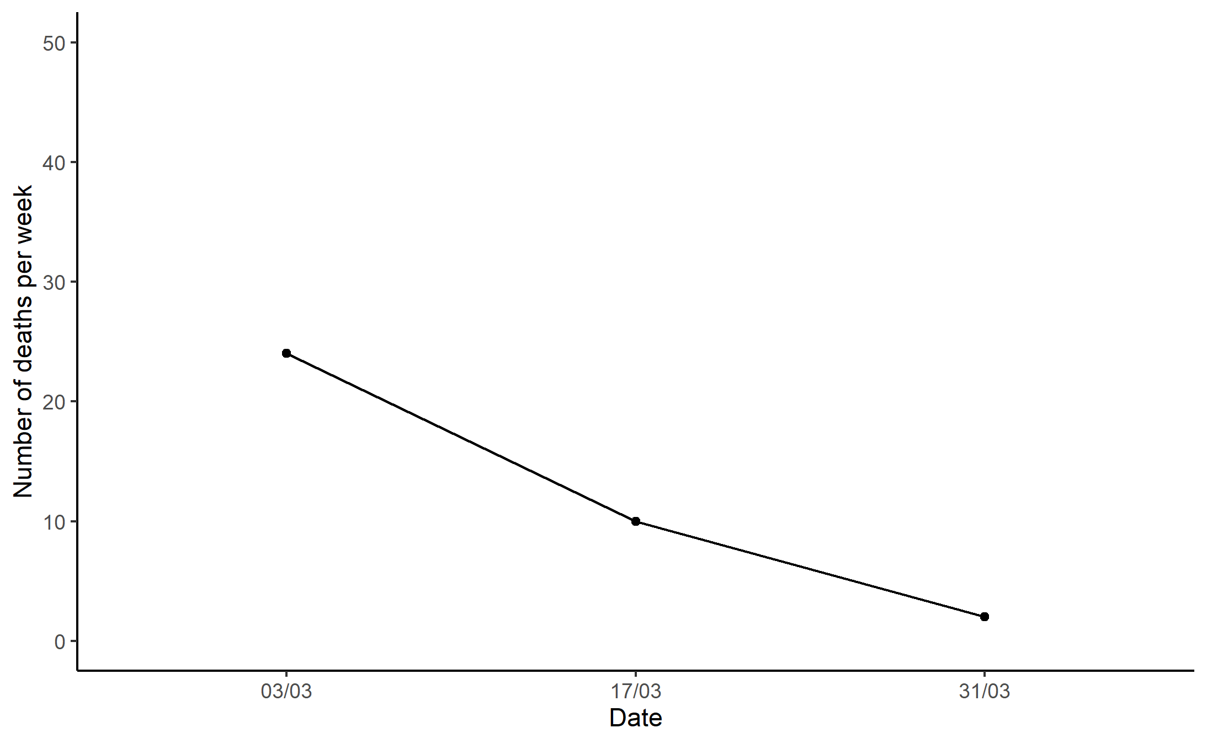
Scenario A: Legionella pneumophila in Inverkeld
Meeting 1:
Public announcement
Epidemiological questionnaire
Investigation of water sources
Treatment of patients
Treatment of water sources

Slide 4
Scenario A: Legionella pneumophila in Inverkeld
Meeting 1:
Public announcement
Epidemiological questionnaire
Investigation of water sources
Treatment of patients
Treatment of water sources
Meeting 2:
Switch off contaminated water sources
Treat contaminated water sources (reopen when compliant)
Public announcement
Treatment of patients (switch antibiotics)

Slide 5
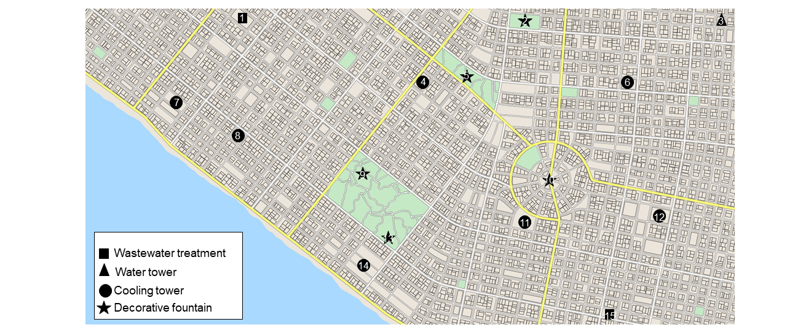
Identification of Legionella-contaminated water sources in Inverkeld

Slide 6
Scenario A: Legionella pneumophila in Inverkeld
Meeting 1:
Public announcement
Epidemiological questionnaire
Investigation of water sources
Treatment of patients
Treatment of water sources
Meeting 2:
Switch off contaminated water sources
Treat contaminated water sources (reopen when compliant)
Public announcement
Treatment of patients (switch antibiotics)

Slide 7
Evaluation of Inverkeld pandemic management?
What went well?
What could have gone better?
What other actions should have been taken (if any)?

Slide 8
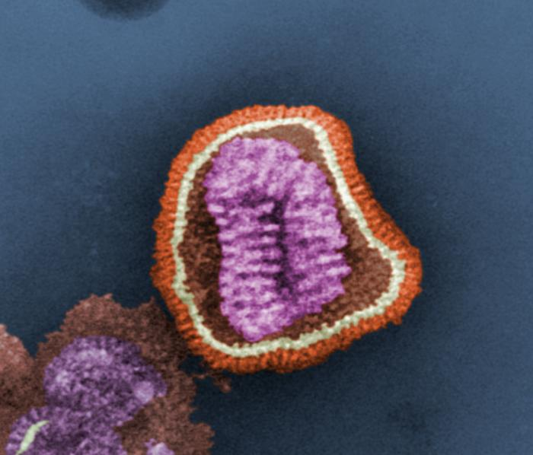
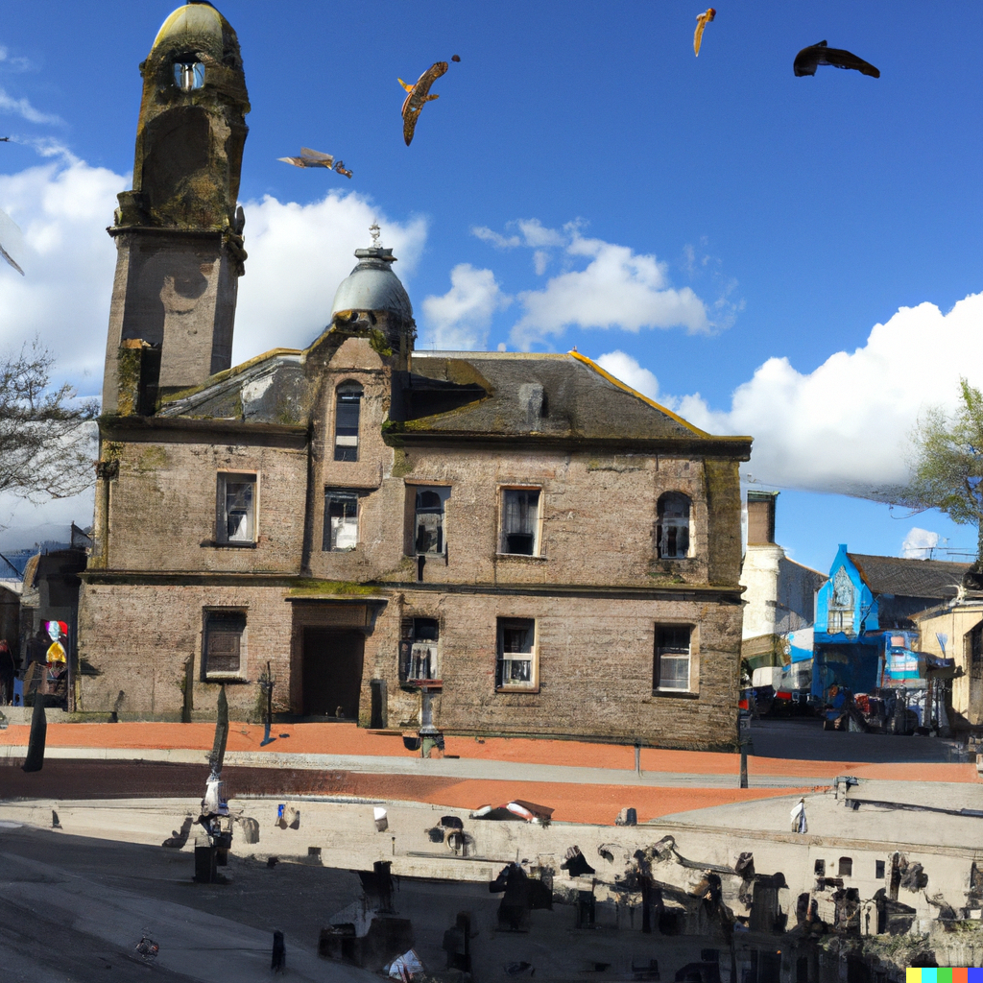
Scenario B: Influenza A in Baltyre

Slide 9
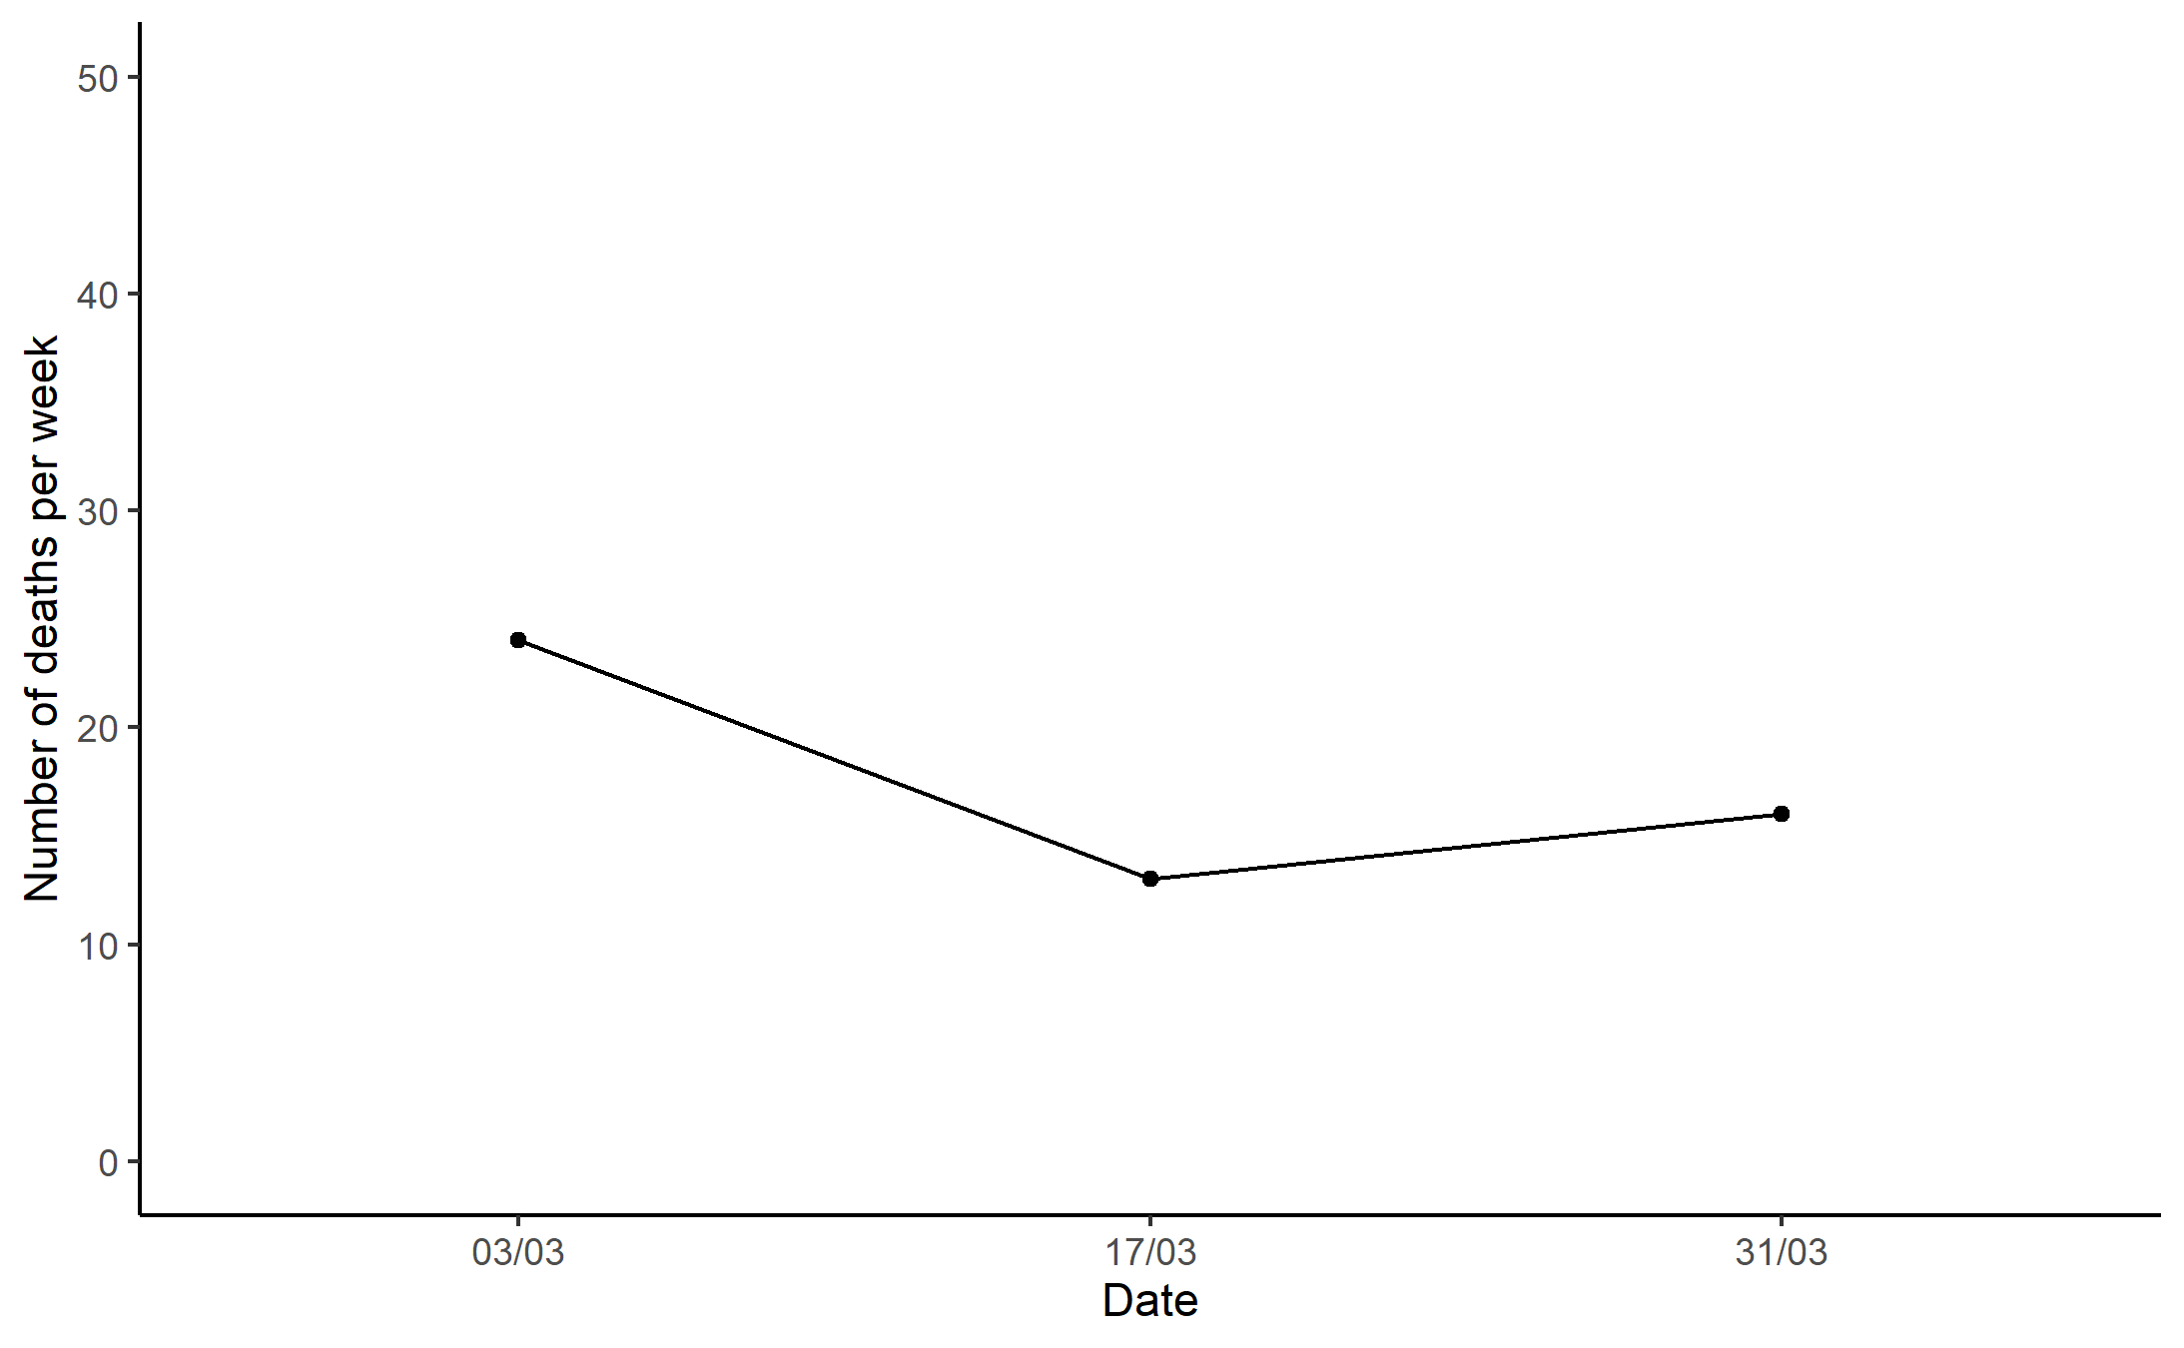
Scenario B: Influenza A in Baltyre
Meeting 1:
Hospital infection prevention measures
Animal testing and isolation
Communications campaign

Slide 10
Scenario B: Influenza A in Baltyre
Meeting 1:
Hospital infection prevention measures
Animal testing and isolation
Communications campaign
Meeting 2:
Communications/town hall meeting
School infection prevention measures
Animal testing and isolation, partial animal culls
Hospital infection prevention measures

Slide 11
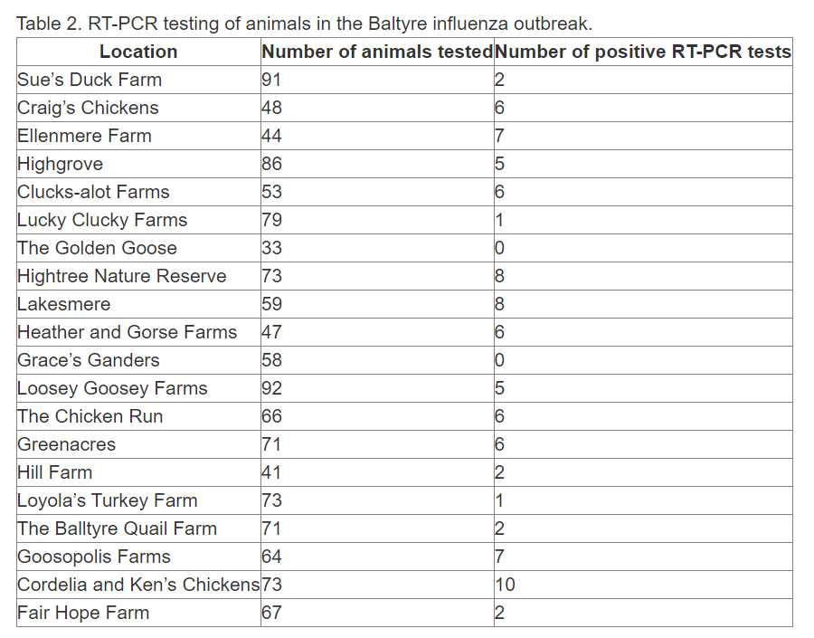
Identification of influenza-infected animals in Baltyre

Slide 12
Scenario B: Influenza A in Baltyre
Meeting 1:
Hospital infection prevention measures
Animal testing and isolation
Communications campaign
Meeting 2:
Communications/town hall meeting
School infection prevention measures
Animal testing and isolation, partial animal culls
Hospital infection prevention measures

Slide 13
Evaluation of Baltyre pandemic management?
What went well?
What could have gone better?
What other actions should have been taken (if any)?

Slide 14
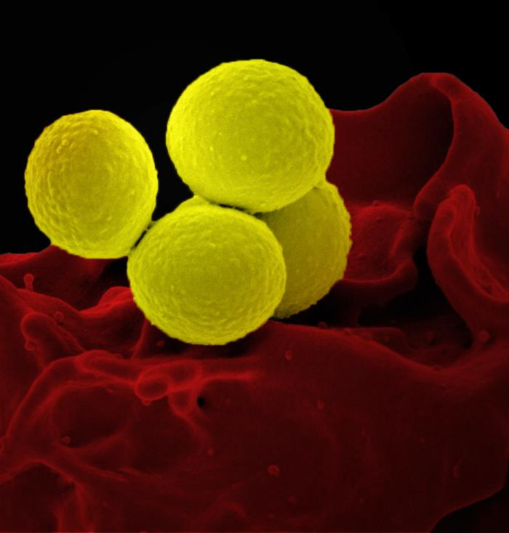
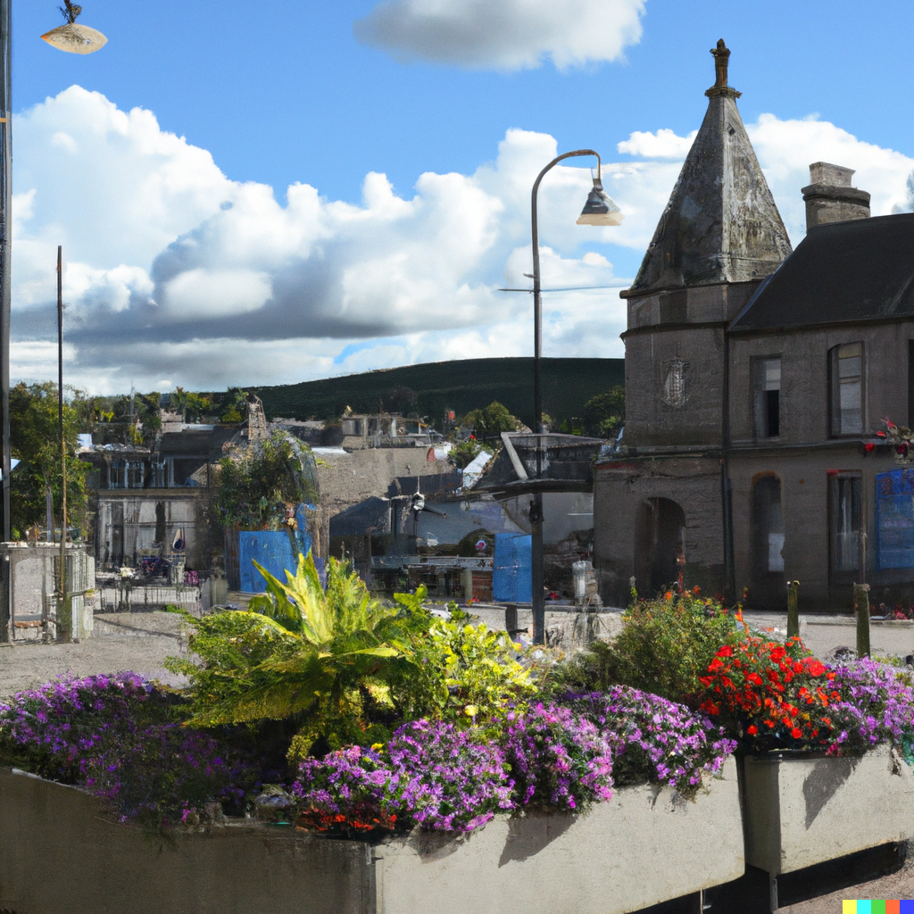
Scenario C: MRSA in Malleith

Slide 15
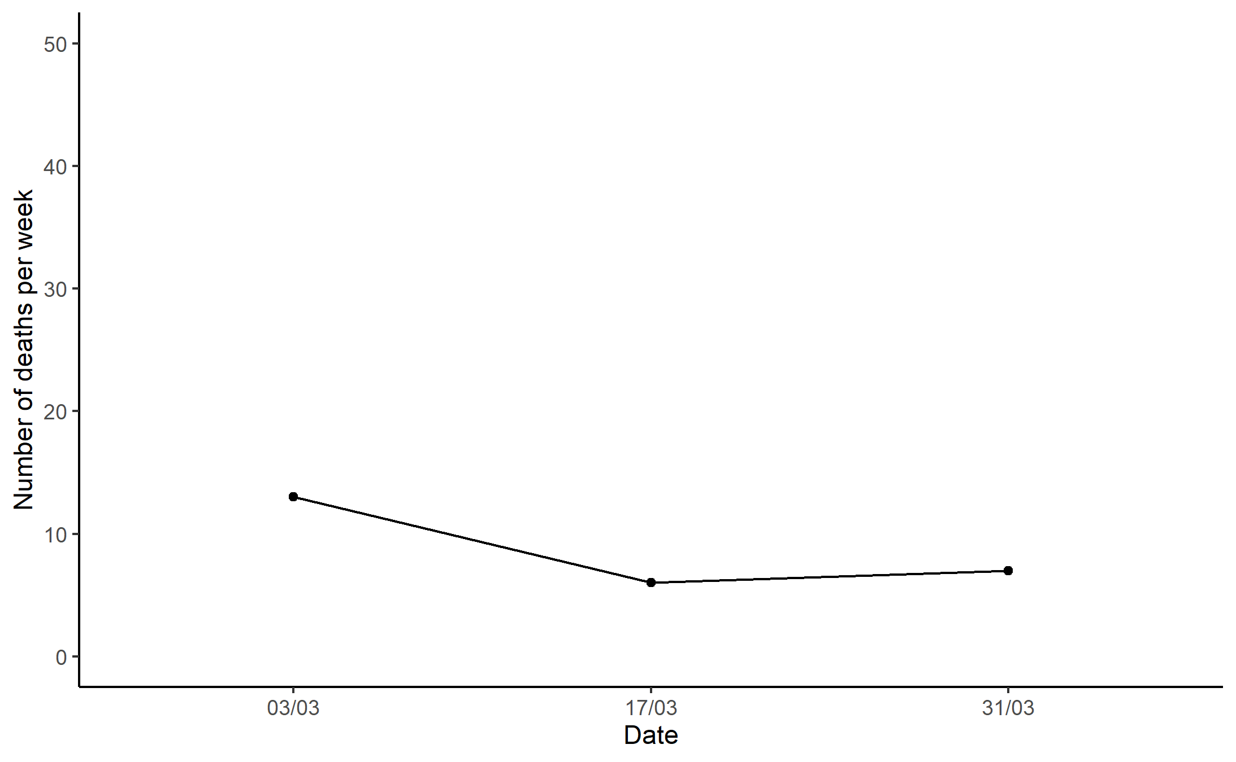
Scenario C: MRSA in Malleith
Meeting 1:
Shut down/cancel public gatherings
Communications campaign
Track and trace
Supply disinfectants to local businesses
Hospital infection control measures
Patient/source testing/identification

Slide 16
Scenario C: MRSA in Malleith
Meeting 1:
Shut down/cancel public gatherings
Communications campaign
Track and trace
Supply disinfectants to local businesses
Hospital infection control measures
Patient/source testing/identification
Meeting 2:
Travel restrictions
Close venues such as pubs, gyms, etc.
Media campaign
Investigate suspected sources
Continue hospital control measures, testing

Slide 17
Scenario C: MRSA in Malleith
Meeting 1:
Shut down/cancel public gatherings
Communications campaign
Track and trace
Supply disinfectants to local businesses
Hospital infection control measures
Patient/source testing/identification
Meeting 2:
Travel restrictions
Close venues such as pubs, gyms, etc.
Media campaign
Investigate suspected sources
Continue hospital control measures, testing

Slide 18
Evaluation of Malleith pandemic management?
What went well?
What could have gone better?
What other actions should have been taken (if any)?

Slide 19
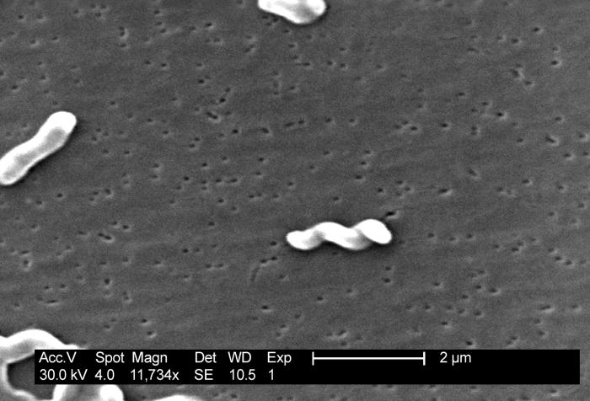
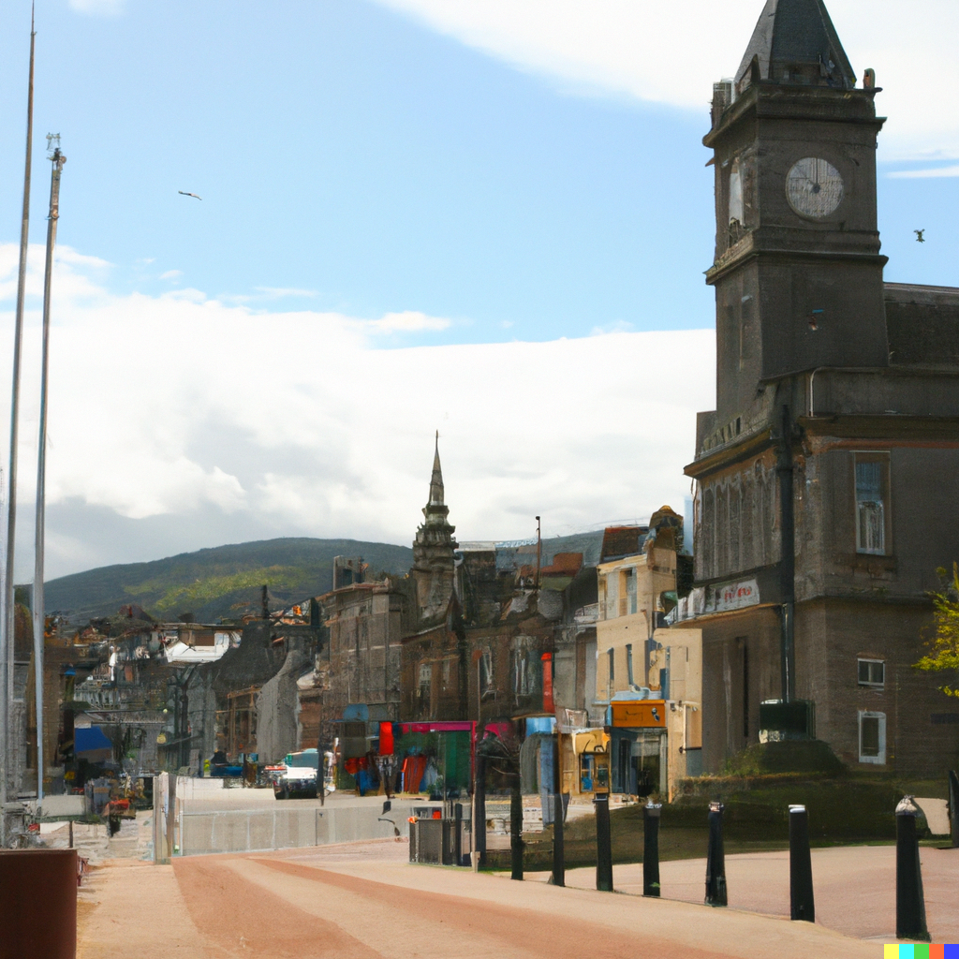
Scenario D: Campylobacter jejuni in Rosblane

Slide 20
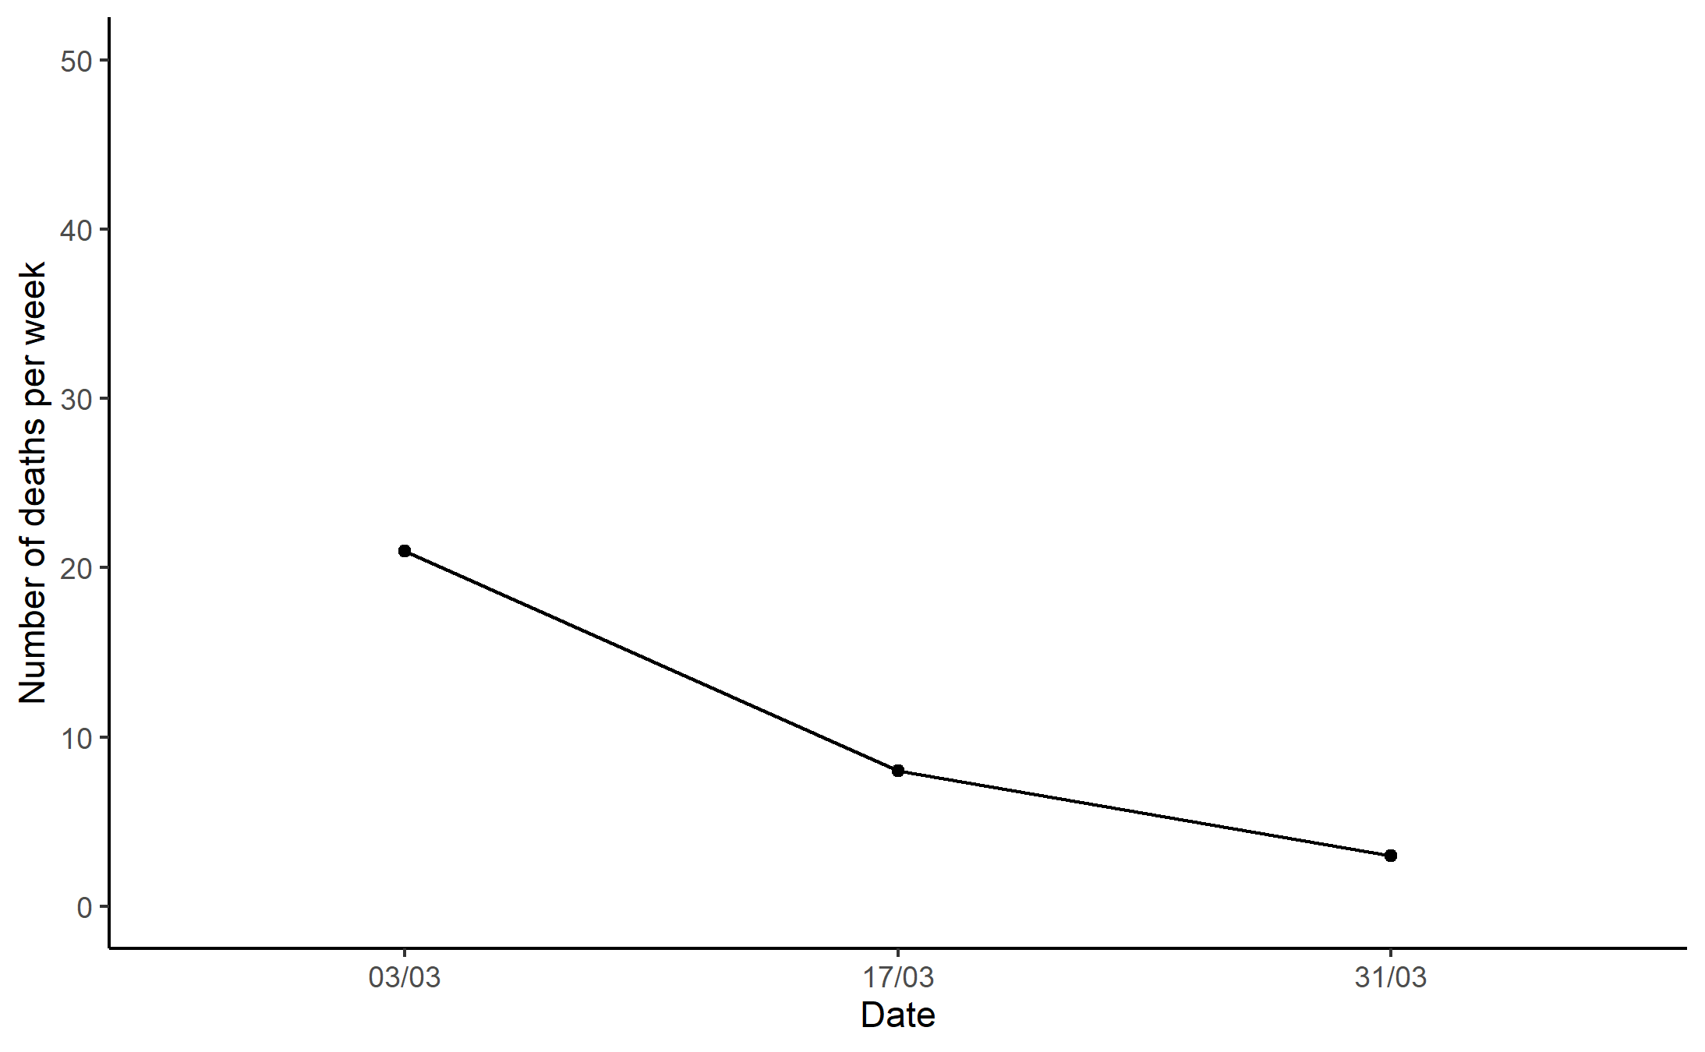
Scenario D: Campylobacter jejuni in Rosblane
Meeting 1:
Public health announcement (food safety)
GPs advised on abx Rx
Test food supply chain for C. jejuni
Track and trace/map cases
Hospital infection control measures

Slide 21
Scenario D: Campylobacter jejuni in Rosblane
Meeting 1:
Public health announcement (food safety)
GPs advised on abx Rx
Test food supply chain for C. jejuni
Track and trace/map cases
Hospital infection control measures
Meeting 2:
Close and clean positive test locations
Test and recall products
Public health announcement
Track and trace – foods consumed
GP advice/farmer survey – abx use

Slide 22
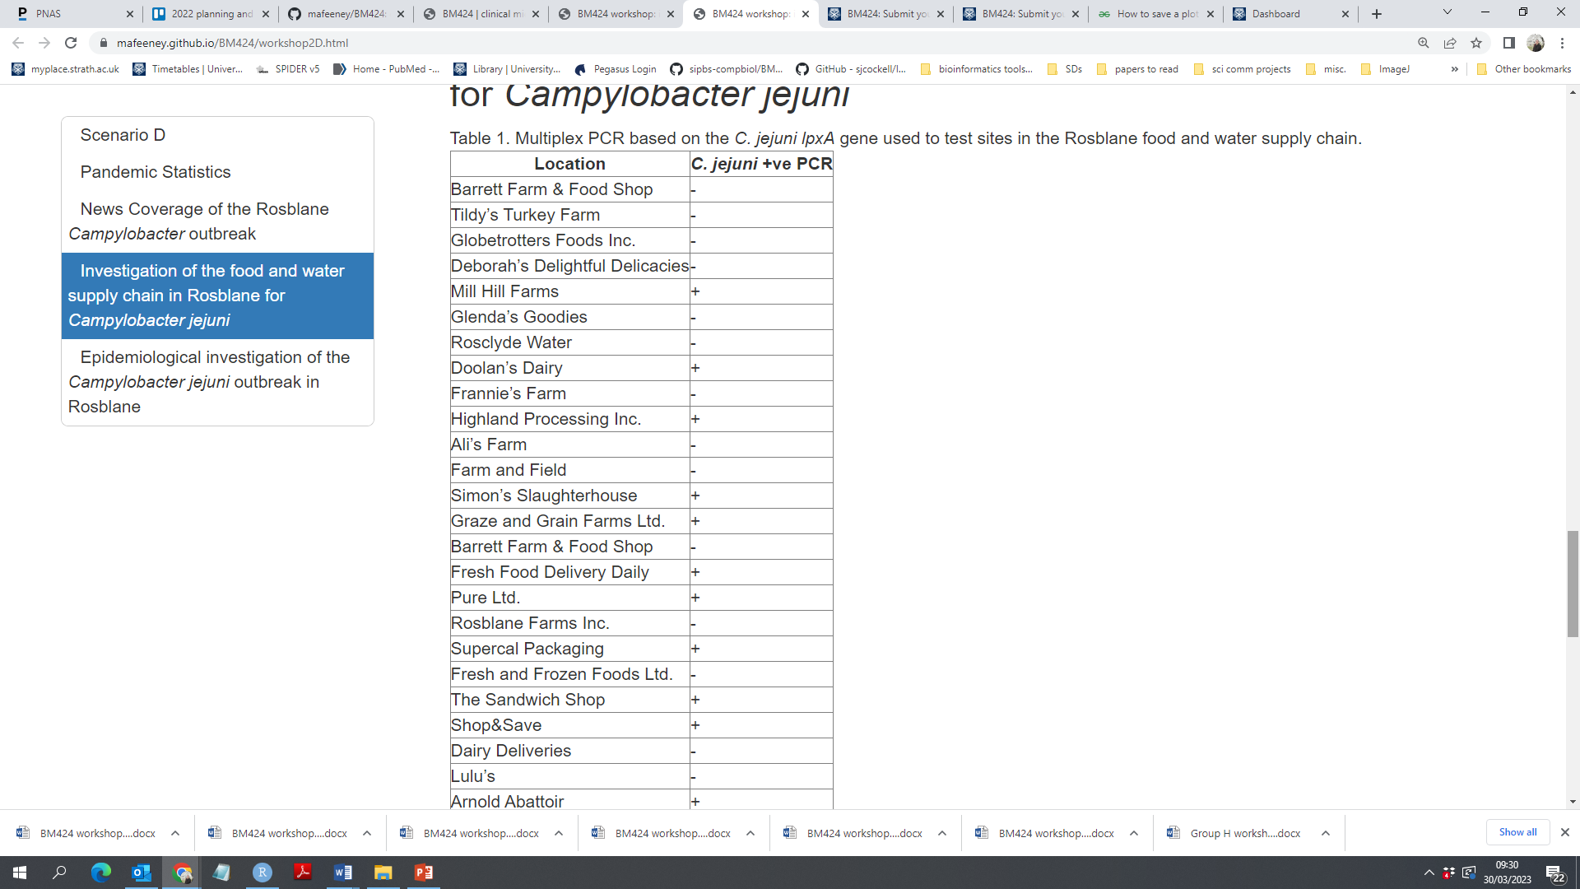
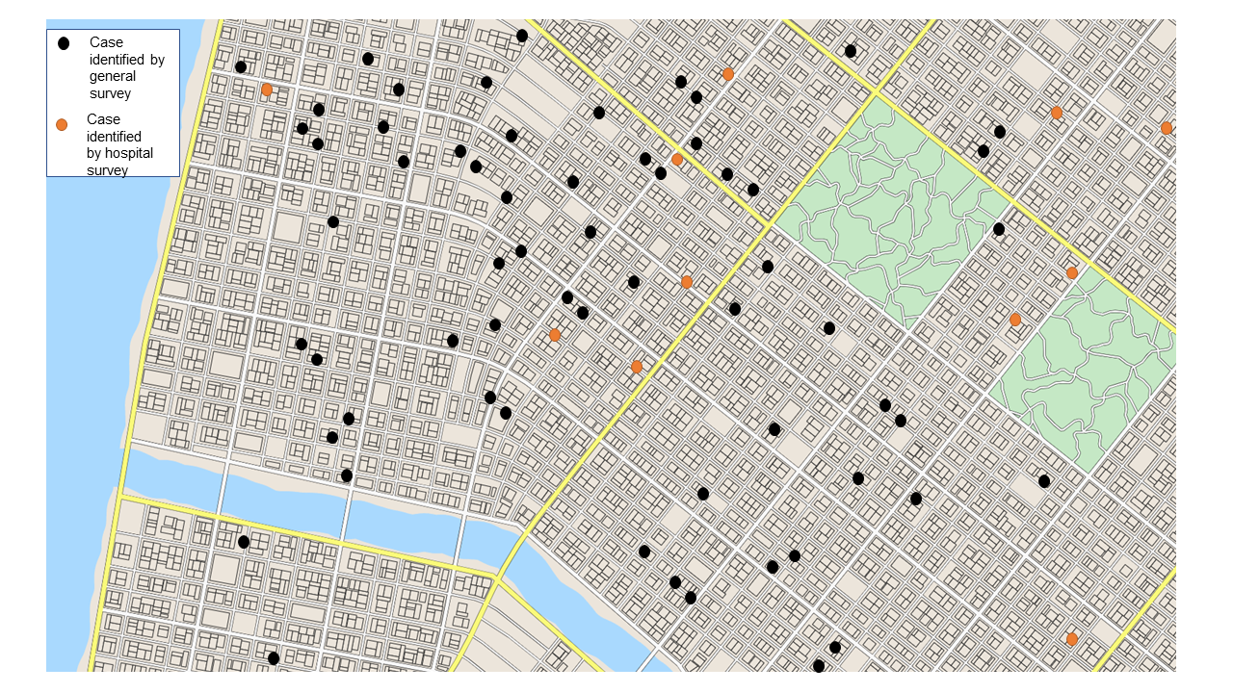
Epidemiology of C. jejuni infections in Rosblane

Slide 23
Scenario D: Campylobacter jejuni in Rosblane
Meeting 1:
Public health announcement (food safety)
GPs advised on abx Rx
Test food supply chain for C. jejuni
Track and trace/map cases
Hospital infection control measures
Meeting 2:
Close and clean positive test locations
Test and recall products
Public health announcement
Track and trace – foods consumed
GP advice/farmer survey – abx use

Slide 24
Evaluation of Rosblane pandemic management?
What went well?
What could have gone better?
What other actions should have been taken (if any)?

Slide 25
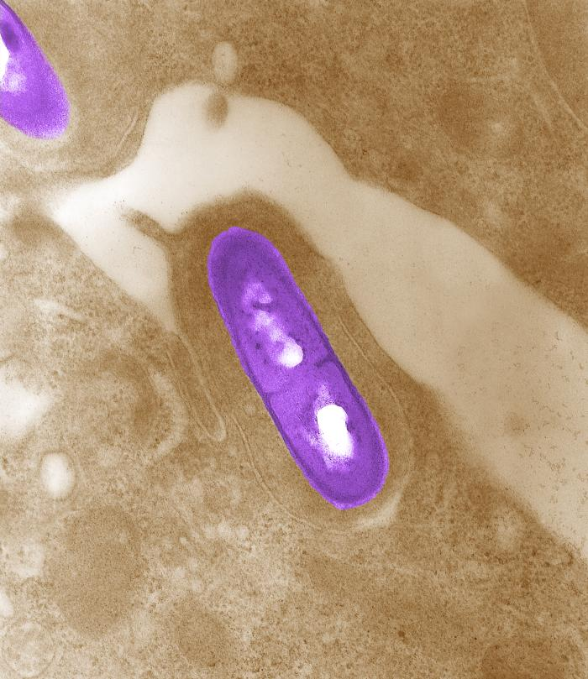
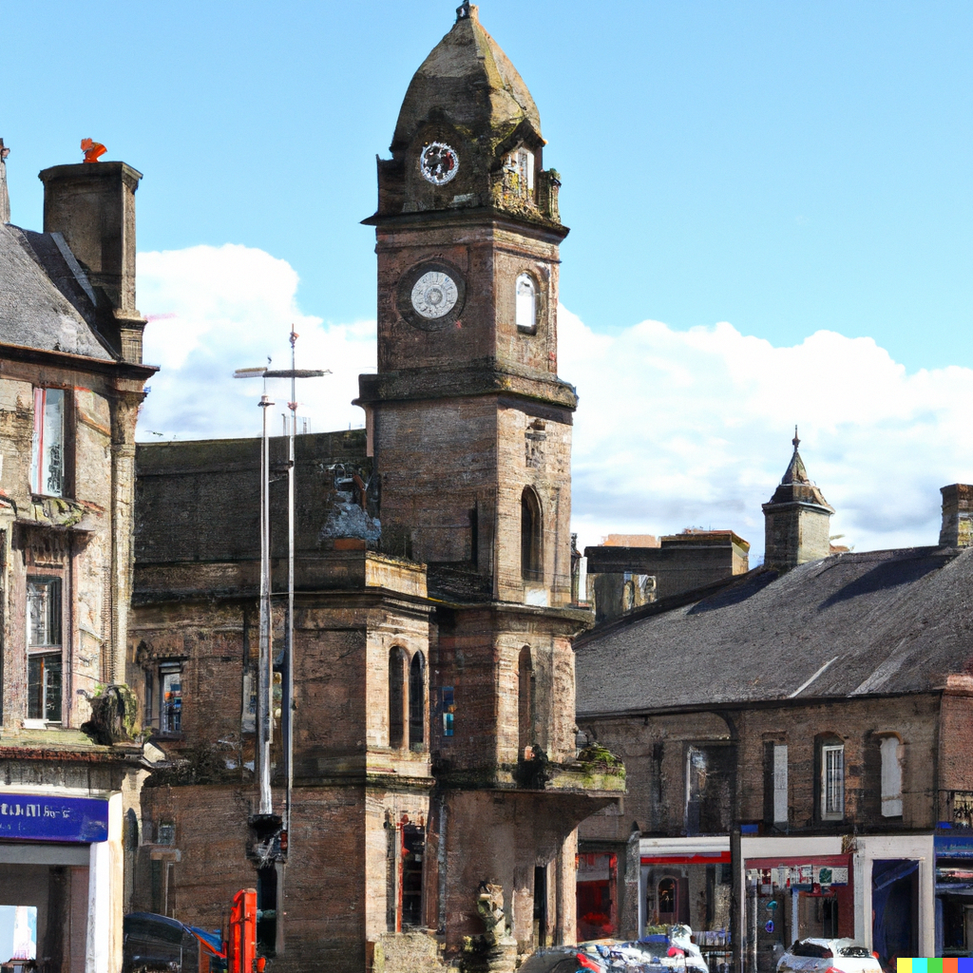
Scenario E: Listeria monocytogenes in Rosmakirk

Slide 26
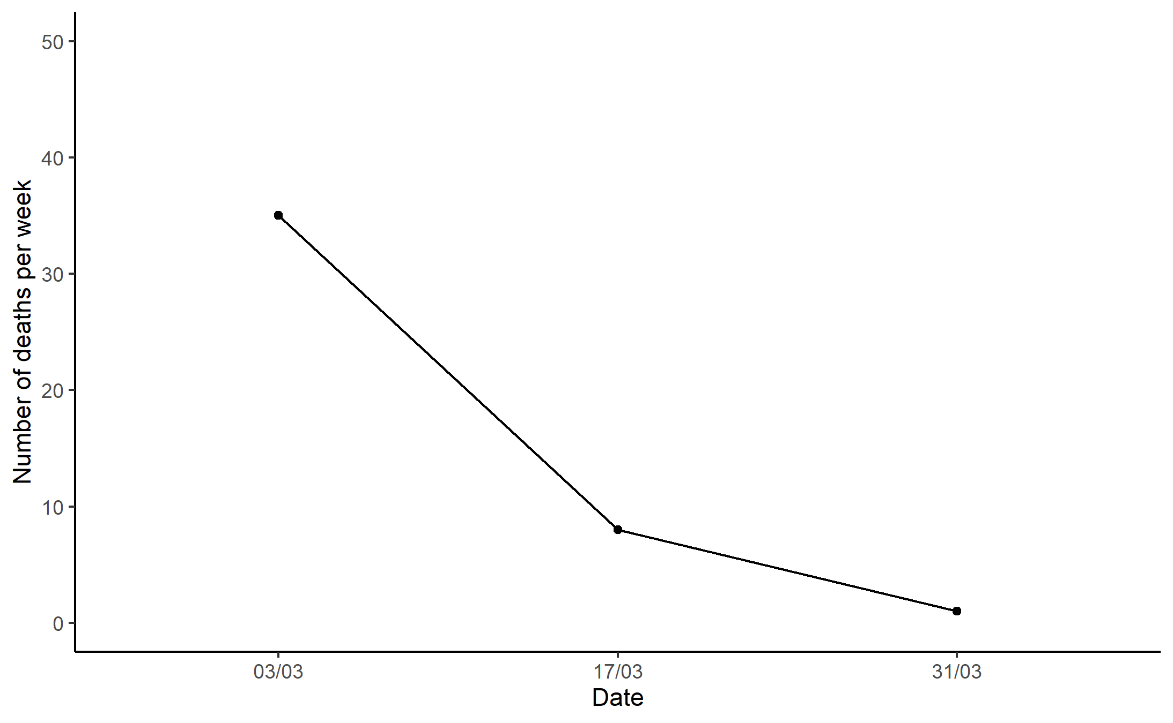
Scenario E: Listeria monocytogenes in Rosmakirk
Meeting 1:
Public awareness campaign
Remove and test suspicious food products
Recall contaminated food products
Test food sources

Slide 27
Scenario E: Listeria monocytogenes in Rosmakirk
Meeting 1:
Public awareness campaign
Remove and test suspicious food products
Recall contaminated food products
Test food sources
Meeting 2:
Continue ad campaign
Disinfect stores/contact areas and retest
Swab testing kits for stores and product sources
Ampicillin for vulnerable patients
Continue frequent testing of food suppliers

Slide 28
Scenario E: Listeria monocytogenes in Rosmakirk
Meeting 1:
Public awareness campaign
Remove and test suspicious food products
Recall contaminated food products
Test food sources
Meeting 2:
Continue ad campaign
Disinfect stores/contact areas and retest
Swab testing kits for stores and product sources
Ampicillin for vulnerable patients
Continue frequent testing of food suppliers

Slide 29
Evaluation of Rosmakirk pandemic management?
What went well?
What could have gone better?
What other actions should have been taken (if any)?

Slide 30
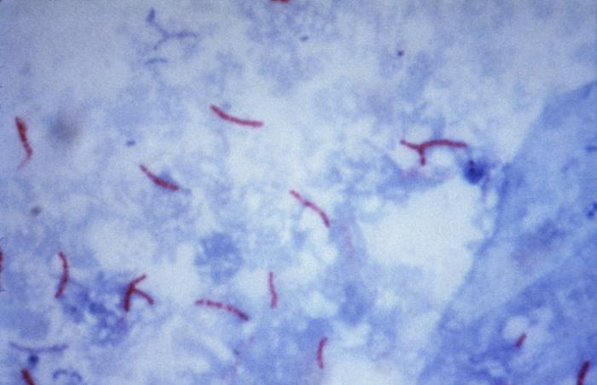
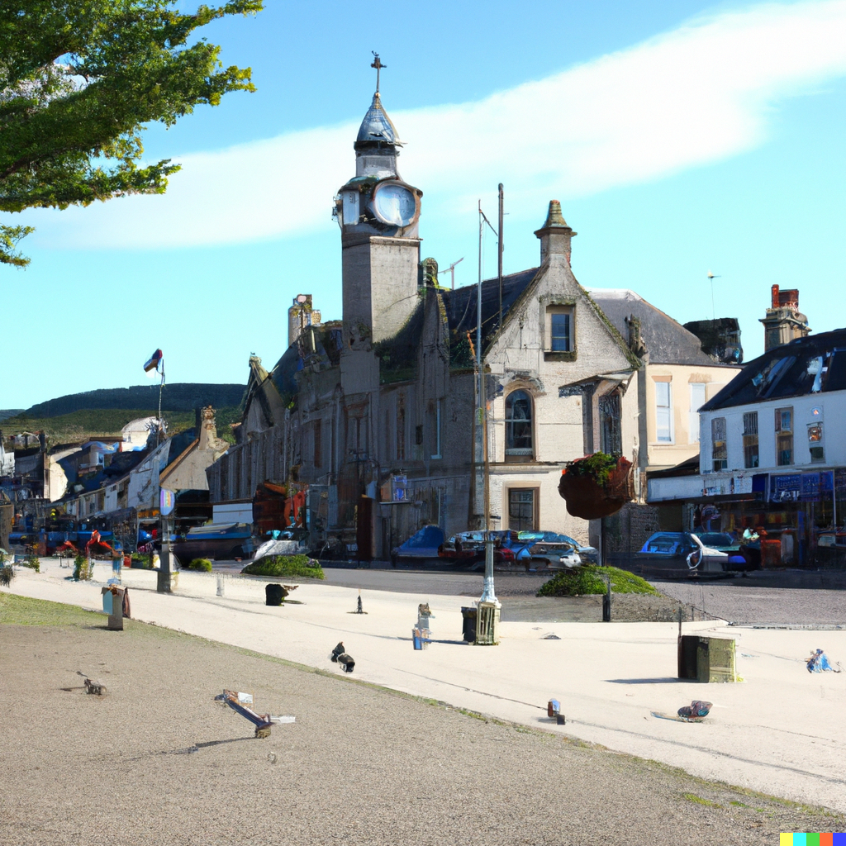
Scenario G: XDR Tb in Glenleith

Slide 31
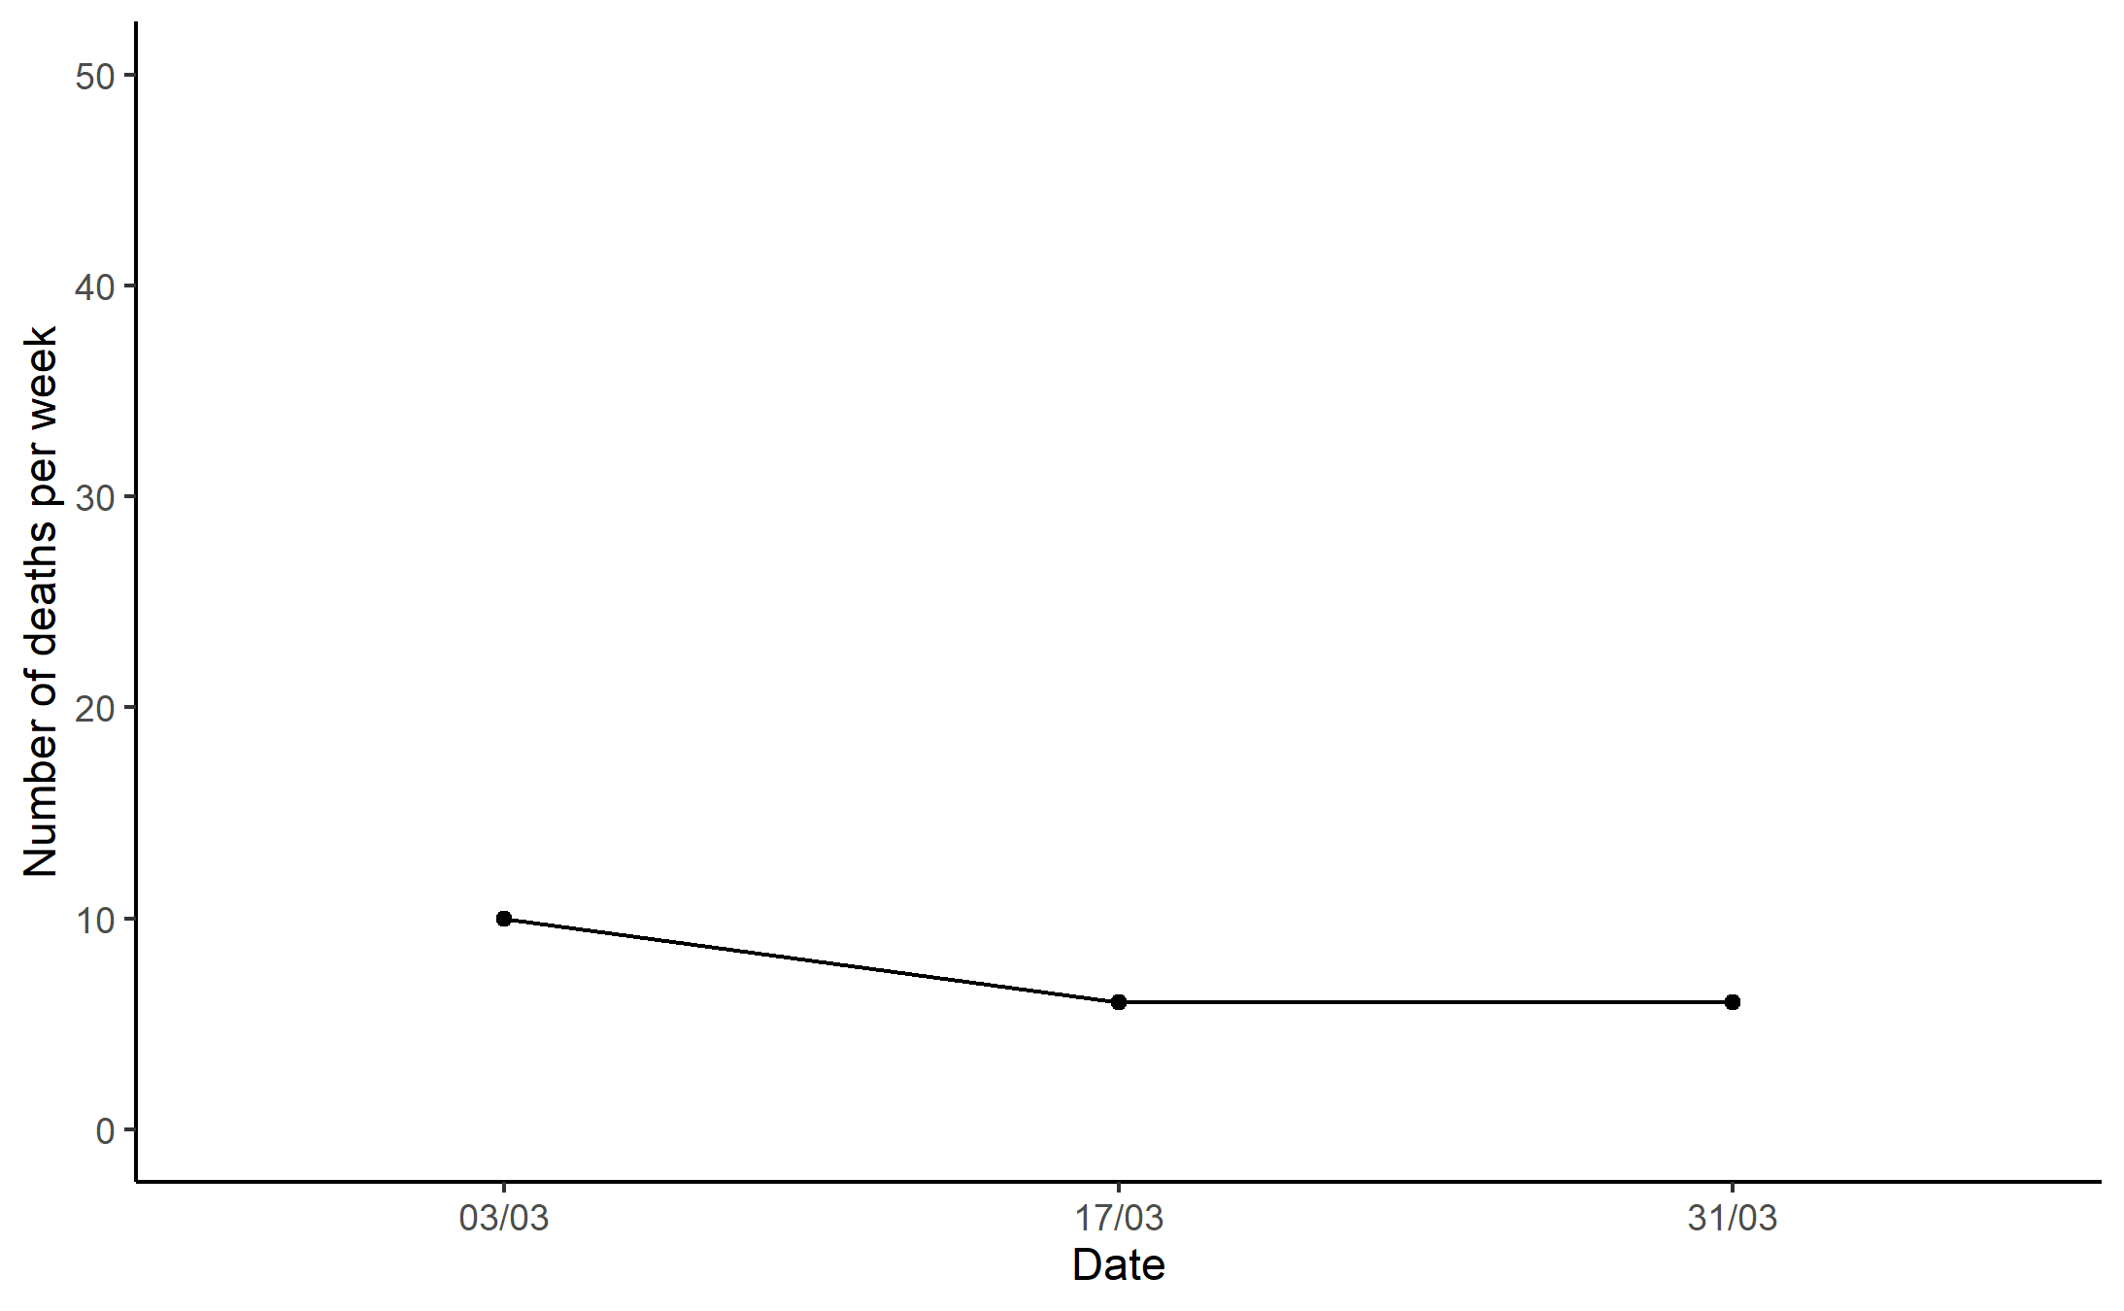
Scenario G: XDR Tb in Glenleith
Meeting 1:
Mandate masks and social distancing
Hospital/drop-in clinic control measures
Awareness campaign
Vaccination campaign
Test, track, and trace

Slide 32
Scenario G: XDR Tb in Glenleith
Meeting 1:
Mandate masks and social distancing
Hospital/drop-in clinic control measures
Awareness campaign
Vaccination campaign
Test, track, and trace
Meeting 2:
Close restaurants and non-essential shops
Increased vaccination campaign
Research new strain/potential therapies
Encourage social bubbles
Social distancing in shops
Non-essential travel prohibited

Slide 33
Scenario G: XDR Tb in Glenleith
Meeting 1:
Mandate masks and social distancing
Hospital/drop-in clinic control measures
Awareness campaign
Vaccination campaign
Test, track, and trace
Meeting 2:
Close restaurants and non-essential shops
Increased vaccination campaign
Research new strain/potential therapies
Encourage social bubbles
Social distancing in shops
Non-essential travel prohibited

Slide 34
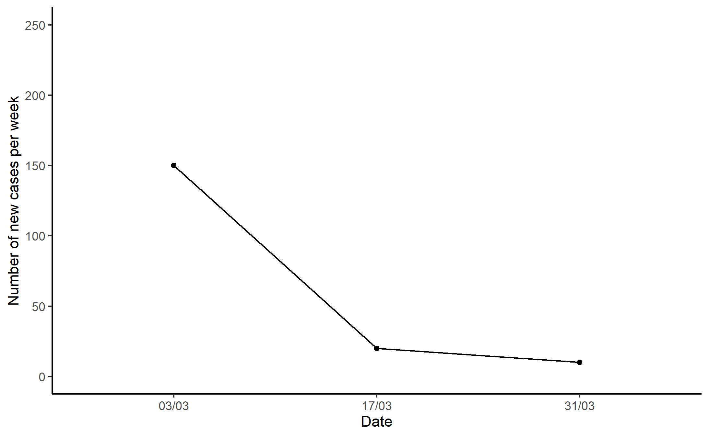
Scenario G: XDR Tb in Glenleith

Slide 35
Evaluation of Glenleith pandemic management?
What went well?
What could have gone better?
What other actions should have been taken (if any)?

Slide 36
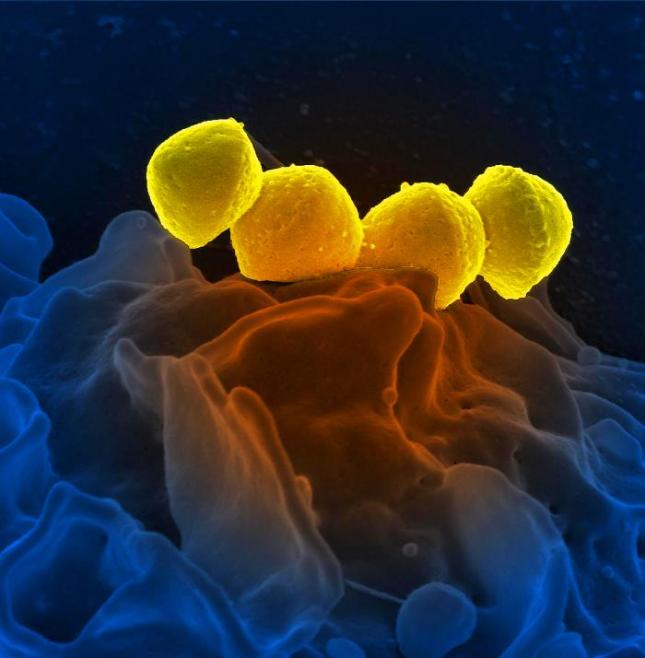
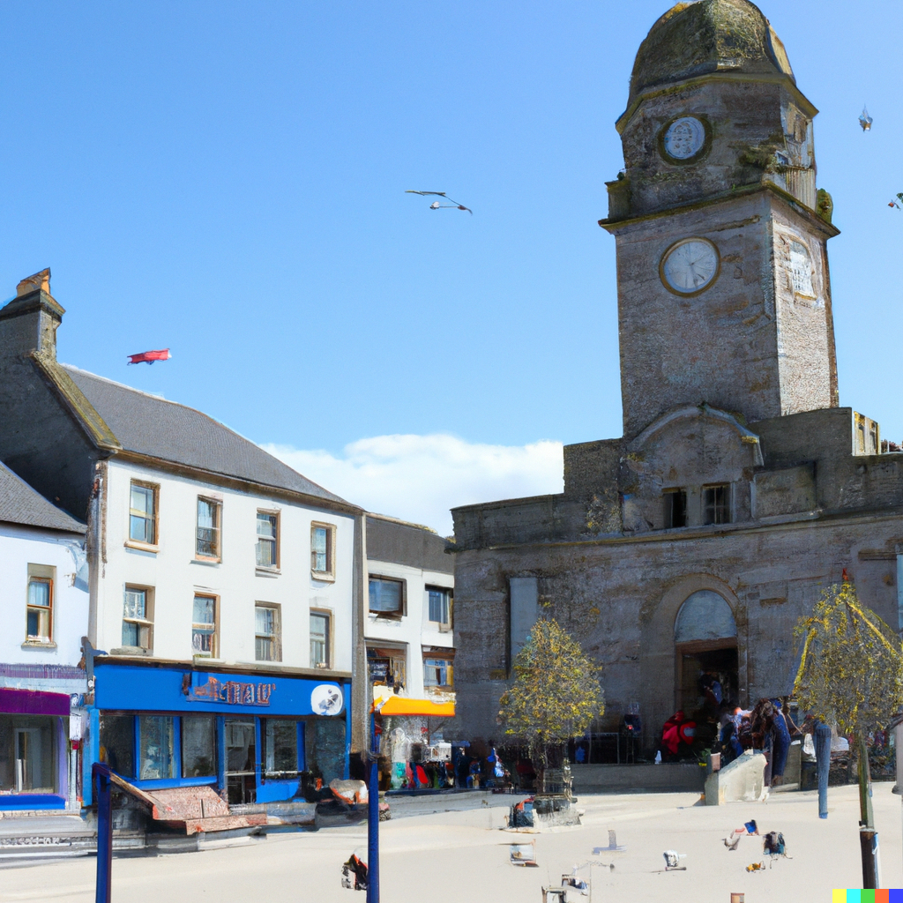
Scenario H: Streptococcus pyogenes in Dalessie

Slide 37
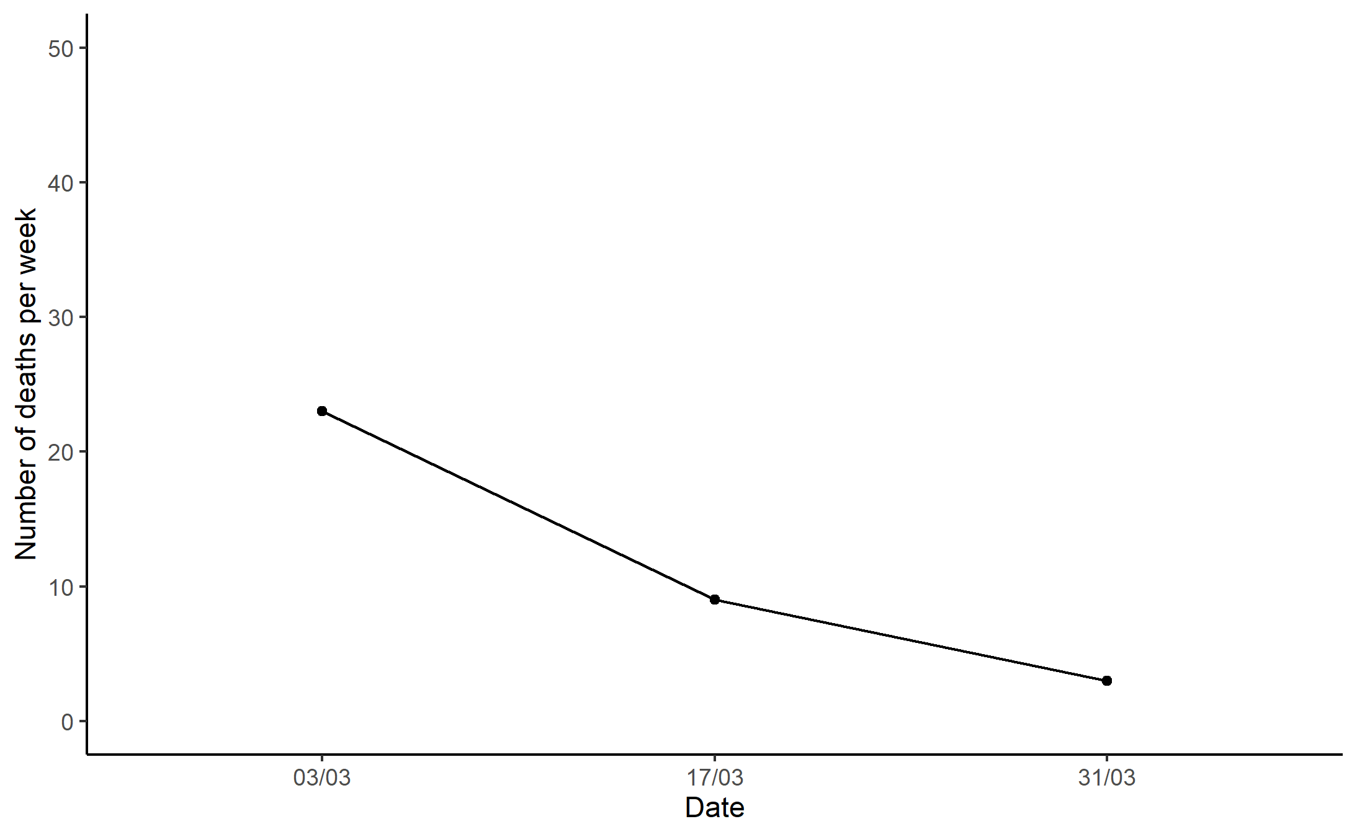
Scenario H: Streptococcus pyogenes in Dalessie
Meeting 1:
School infection control measures
Masks/distancing
Contact tracing
Increased testing
Preventative abx for elderly
TV ad

Slide 38
Scenario H: Streptococcus pyogenes in Dalessie
Meeting 1:
School infection control measures
Masks/distancing
Contact tracing
Increased testing
Preventative abx for elderly
TV ad
Meeting 2:
Collect more epidemiological data
Public relations campaign
Increased contact tracing
Continue previous actions

Slide 39
Scenario H: Streptococcus pyogenes in Dalessie
Meeting 1:
School infection control measures
Masks/distancing
Contact tracing
Increased testing
Preventative abx for elderly
TV ad
Meeting 2:
Collect more epidemiological data
Public relations campaign
Increased contact tracing
Continue previous actions

Slide 40
Evaluation of Dalessie pandemic management?
What went well?
What could have gone better?
What other actions should have been taken (if any)?

Slide 41
Overview/lessons learned:
What strategies work well for pandemic management?
Where/how can we improve the way we respond to pandemics? (Roles for new technology/innovations?)

